Slide 1
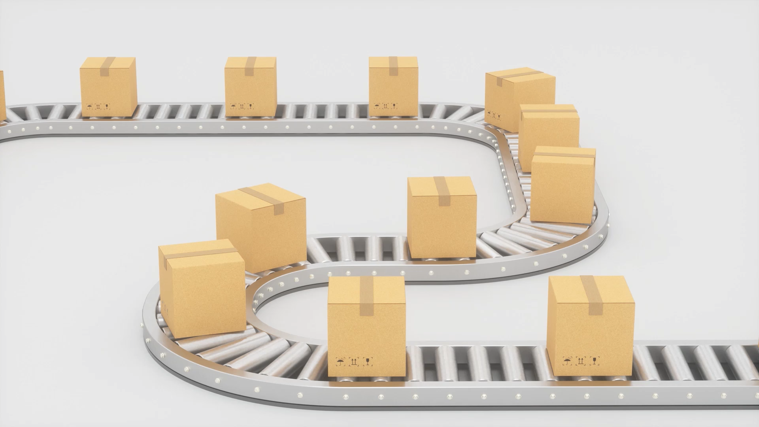
Containerized Shipments
The Docker Adventure Begins

Slide 2
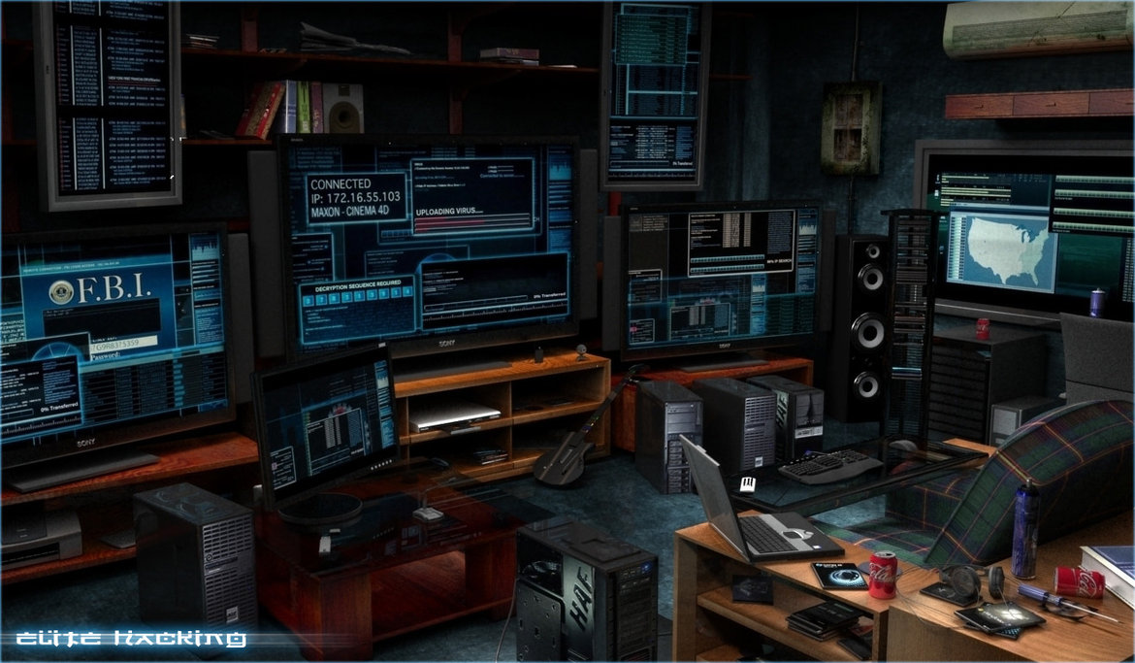
About Me
Yash Patel
8+ Years in Hacking Securing Software & System
Software Security & Reliability @ Azure Speech AI (Microsoft HQ)
Security Architect @ CyberNGO

Slide 3
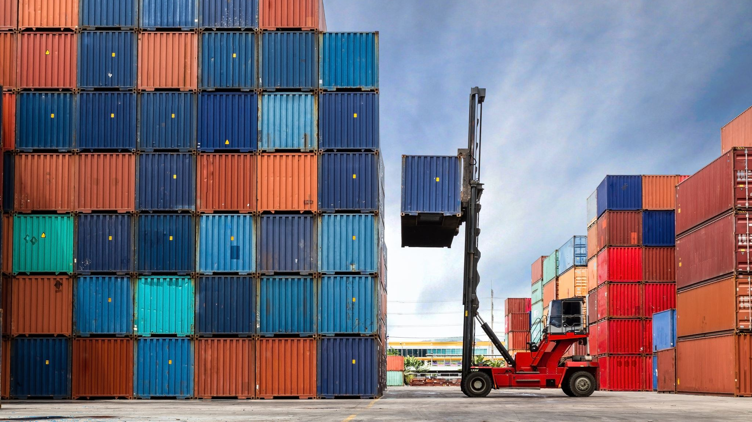
The Docker Adventure Begins
Docker 101

Slide 4
Session Outline
Introduction to Docker
Docker SDLC Workflow & Docker Architecture
Installing Docker
Custom Dockerfile + Docker Build Compose
Deploy container

Slide 5

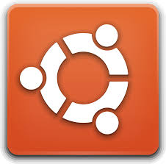
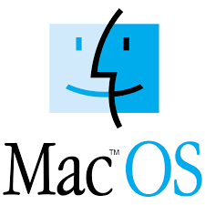
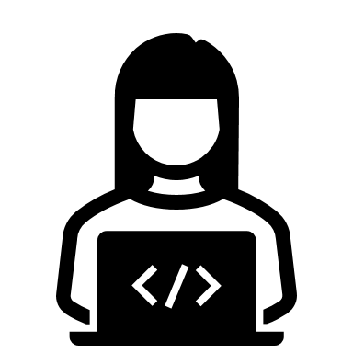

Traditional Application Development Challenges
Manual installation of dependencies on various operating systems leads to inconsistencies.
Complex setup processes increase the risk of errors and configuration issues.

Slide 6
Write Application Code
Install Required Dependencies
Test it locally
Prepare deployment artifacts.
Install Required Dependencies on production servers where you want to deploy your app.
Now deploy your built app artifacts and then test in production
Engineer’s Life without Docker
Write Application Code
Write and Build Dockerfile & Image
Deploy the docker container on server
Engineer’s Life with Docker

Slide 7
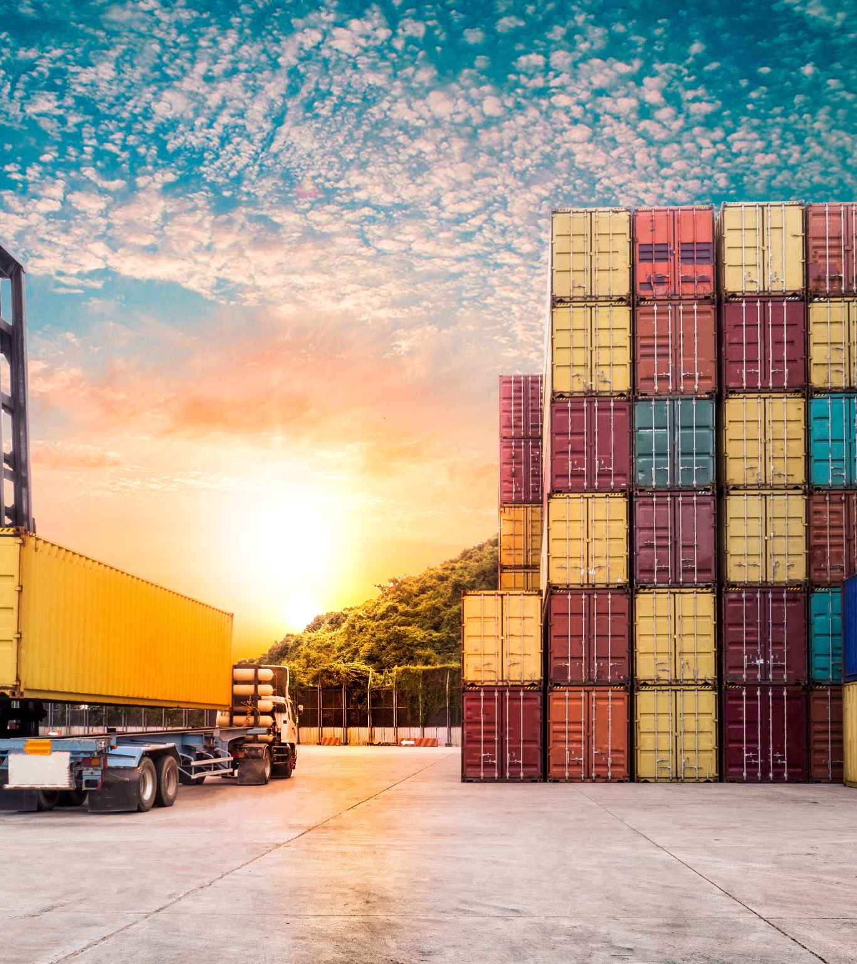
Introduction to Docker
Docker is a virtualization software that simplifies application development and deployment by packaging applications into containers.
Containers include everything an application needs to run, ensuring consistency across different environments.

Slide 8
Introduction to Containers
Containers encapsulate applications and their dependencies, providing isolated environments.
They ensure that applications run the same, regardless of where they're deployed.
Containers = Application + Necessary dependencies + Configuration + System tools + OS Runtime

Slide 9
Docker's Role in Development
Standardizes the process of running services across different environments like Dev, Test and Production.
Simplifies environment setup with consistent Docker commands, reducing setup time.

Slide 10
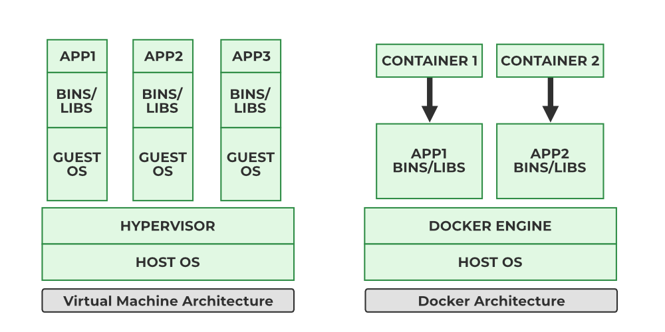
Docker vs. Virtual Machines
Virtual Machines (VMs) virtualize entire operating systems, leading to larger sizes and slower startups.
Docker virtualizes at the application level, resulting in lightweight containers with faster startup times.
Notes:
Container => Lightweight, Efficient, Quick start, Process-Level separation, Highly Portable, Minimal overhead, Lighter Isolation, No OS Patching or manual software upgrade

Slide 11
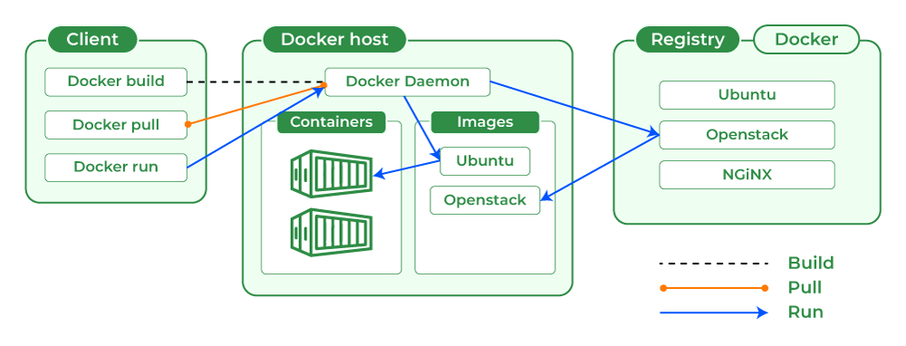
Understanding Docker Architecture
Includes Docker Engine, the core service enabling containerization.
Provides both Command Line Interface (CLI) and Graphical User Interface (GUI) for managing Docker resources.

Slide 12

Installing Docker
Download Docker Desktop from the official Docker website.
Follow installation instructions specific to your operating system (Windows, macOS, or Linux).
https://www.docker.com/
Notes:
Open Docker Desktop and explain each tabs there and some settings

Slide 13
Explore Docker Desktop
Docker Engine
Docker CLI Client

Slide 14
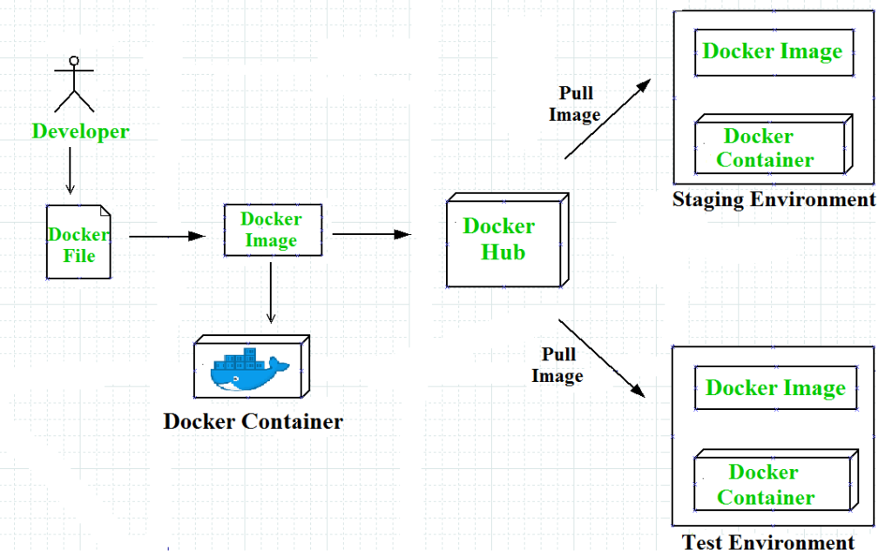
Docker SDLC Workflow

Slide 15
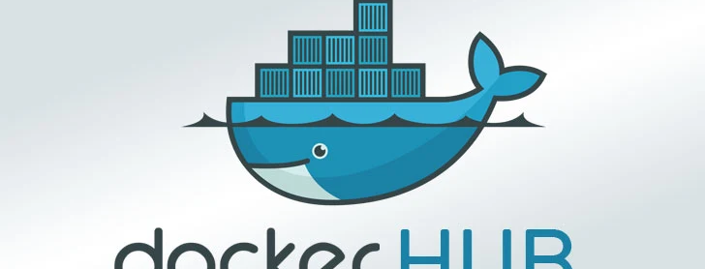
Working with Docker Hub
Docker Image Registry
Docker images are read-only templates used to create containers.
They can be obtained from Docker Hub or built locally.
Notes:
docker pull nginx:latest
docker images
docker run nginx
docker ps
docker run –d nginx
docker ps
docker logs

Slide 16
Understanding Docker Containers
Containers are runtime instances of Docker images.
They can be started, stopped, and managed using Docker commands.
docker pull nginx:latest
docker images
docker run nginx
docker run –d nginx
docker ps
docker logs
docker start nginx
docker stop nginx
docker restart nginx

Slide 17
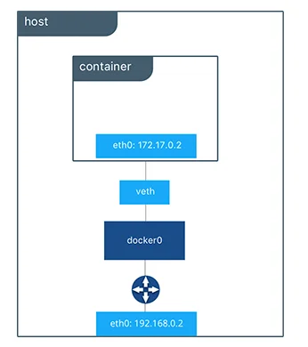
Docker Networking Basics
Docker provides default networks for containers to communicate.
Port Binding: Ports can be exposed to allow external access to container services.
Notes:
docker run –d –p 9000:80 nginx
docker run –name webApp –d –p 9000:80 nginx
docker ps
docker ps -a

Slide 18
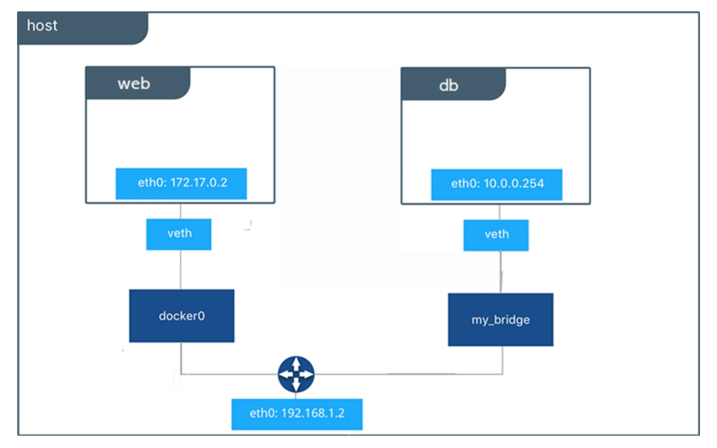
Docker Networking Basics (Continue)

Slide 19
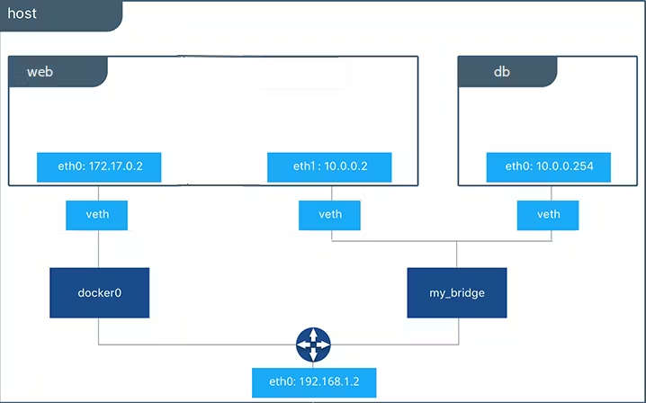
Docker Networking Basics (Continue)

Slide 20
Data Management in Docker
Volumes and bind mounts are used to persist data outside of containers.
This ensures data isn't lost when containers are removed or updated.

Slide 21
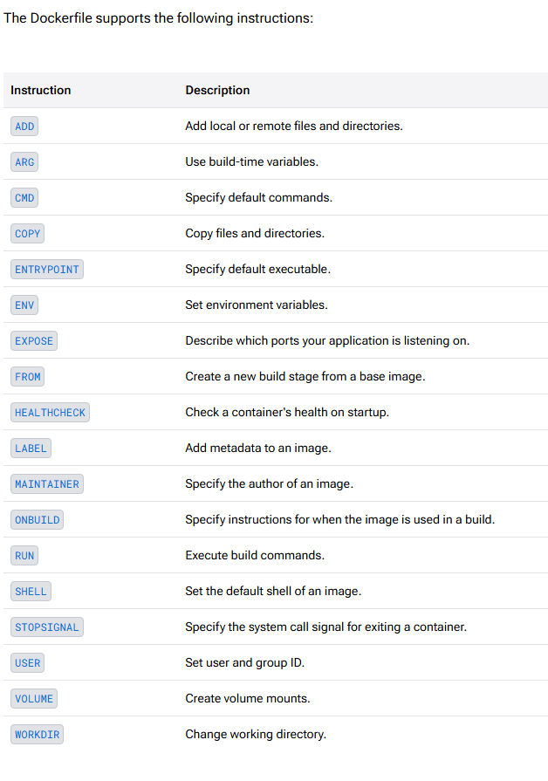
Creating Own Custom Docker Images
Use a Dockerfile to define the steps needed to create a custom image.
Build the image using the docker build command.

Slide 22
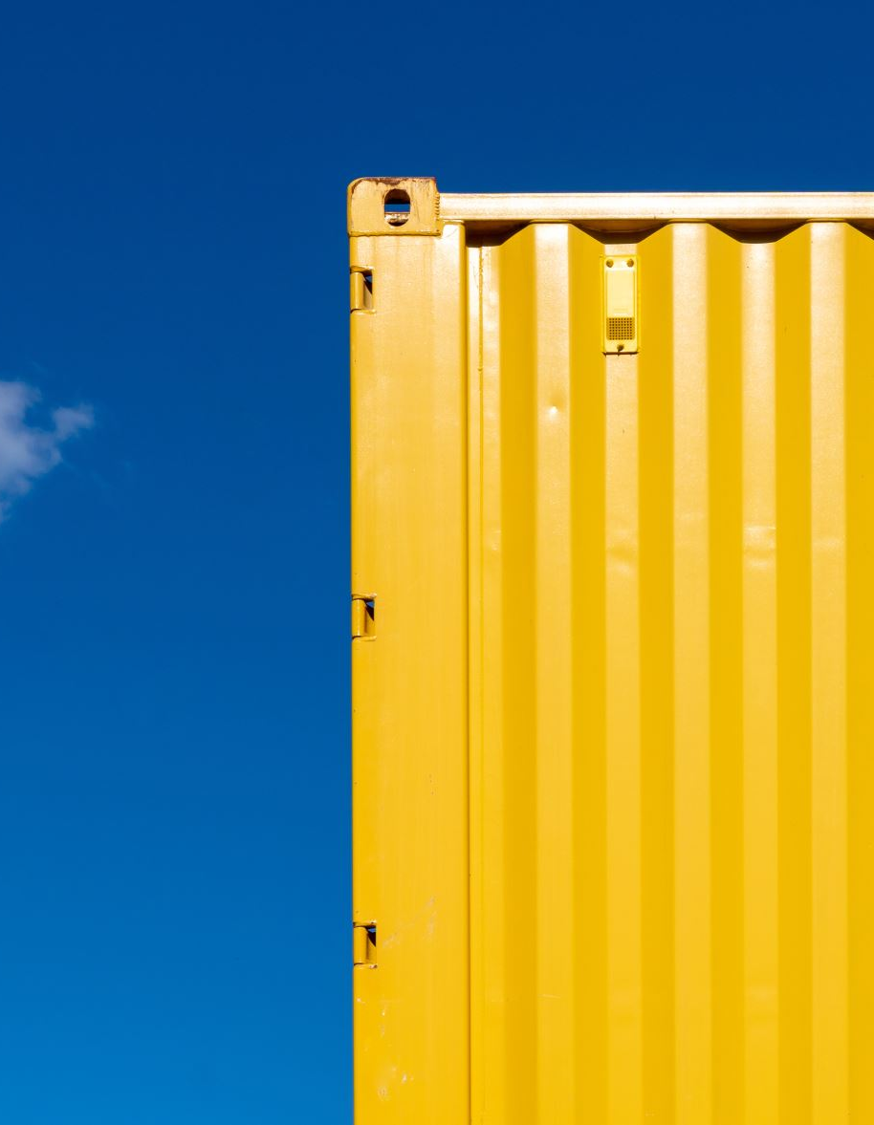
Create Custom Dockerfile
Pull OS Layer image
Copy Files to container
Pull Service dependency
Environment variable setup
Container resources setup
Application artifacts configure on container
…..Build Dockerfile, and deploy container from built image
Notes:
docker -help
docker build -t FirstApp .
docker images
docker run –it –d –p 8080:80 FirstApp
docker ps
docker init

Slide 23
Common Docker Commands Cheat Sheet
Download an image from a registry.
Create and start a new container from an image.
List running containers.
Stop a running container.
docker pull [image]
docker run [image]
docker ps
docker stop [container]
Remove a container.
docker rm [container]

Slide 24
Session Recap
What’s Container ? Why do we need it ?
Introduction to Docker, Docker hub, Docker CLI
How Docker container works – Docker Architecture, Networking, Disk
How to pull/run/debug container image
How to create own custom container image
Basic Docker commands

Slide 25
Docker Compose
Docker Compose allows defining and running multi-container Docker applications.
Services, networks, and volumes are specified in a docker-compose.yml file.

Slide 26
Best Practices for Docker Images
Keep images lightweight by minimizing the number of layers and dependencies.
Regularly update images to include security patches and improvements.

Slide 27
Security Considerations
Run containers with the least privilege necessary.
Scan images for vulnerabilities before deployment.

Slide 28
Docker in CI/CD Pipelines
Integrate Docker to ensure consistent environments across development, testing, and production.
Automate building, testing, and deployment processes using Docker.

Slide 29
Scaling with Docker Swarm
Docker Swarm enables clustering and orchestration of multiple Docker nodes.
Facilitates scaling applications horizontally by adding or removing containers.

Slide 30
Monitoring Docker Containers
Use tools like Docker stats and logs to monitor container performance and health.
Implement logging mechanisms to track and debug container activities.

Slide 31
Conclusion and Next Steps
Micro-Services Architecture
01
Kubernetes
02
Kubernetes + Docker + Azure Cloud = Azure Kubernetes Service (AKS)
03
Git for CI/CD
04
Helm templatization for Kubernetes cluster
05
Notes:
Recap: Docker simplifies application development and deployment through containerization.
Encouragement to explore advanced topics like orchestration with Kubernetes and integrating Docker into complex workflows.

Slide 32

References
https://www.docker.com/resources/what-container/
https://docs.docker.com/
https://youtu.be/pg19Z8LL06w
https://youtu.be/SXwC9fSwct8
https://www.geeksforgeeks.org/docker-or-virtual-machines-which-is-a-better-choice/

Slide 33

Thank You

Slide 34

Connect 1:1

